Slide 1

DIVISI WEB UKM IPTEK
SOME KNOWLEDGE ABOUT WEBSITE
AND INSTALLATION SOFTWARE
UKM IPTEK CIC – http://www.iptekcic.com – iptekcic@gmail.com

Slide 2

Kenapa Divisi Web ?
IOT
Desktop
WEB

Slide 3
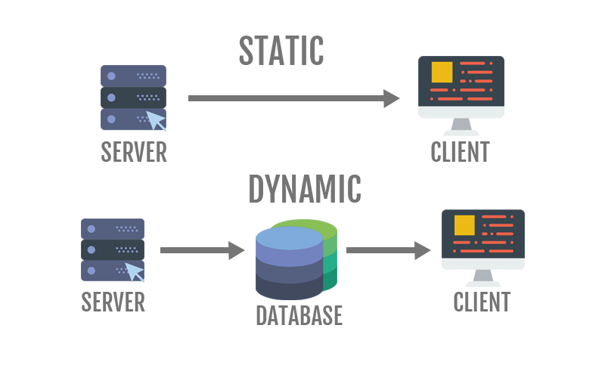
Dynamic Web X Static Web

Slide 4
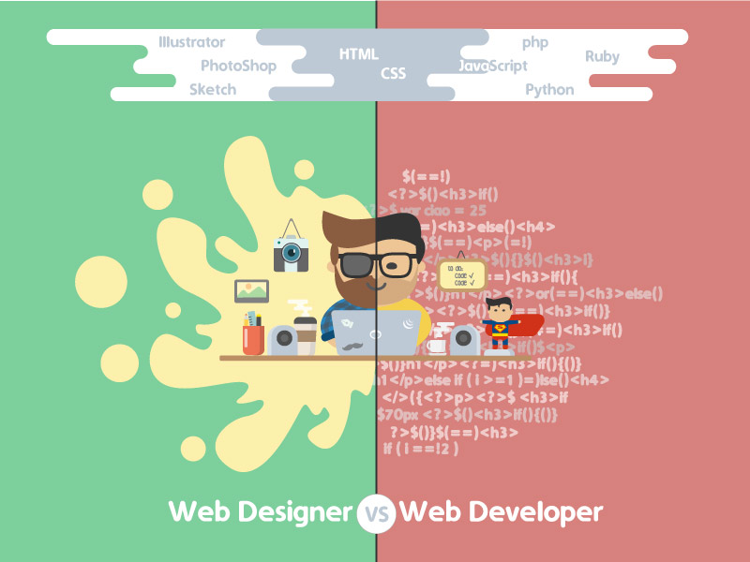
Web Developer X Web Designer
Pict Source : http://dribbble.com

Slide 5
What will we learn ?
PHP
HTML
CSS
JS

Slide 6
TOOLS
Sublime Text/Atom/VS Code
Chrome/Mozilla Firefox/Internet Explorer
Apache Web Server
MySQL Database

Slide 7
“Yang mau akan mencari jalan, yang tidak
mau akan mencari alasan”
- Sekolahkoding -

Slide 8
Are You Ready ?

